Slide 1
Hypothesising and Predicting

Slide 2

In this Smart Lesson you will learn how to:
Explain what a hypothesis is.
Identify the dependent and independent variables in a hypothesis.
Propose a hypothesis to investigate.

Slide 3
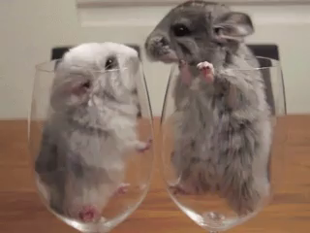
Some questions can be tested by a scientific experiment.
For example, "Does the drug Blogoflycin affect the life span of adult mice?"
An experiment could then be designed in which some mice are given Blogoflycin and some aren't.

Slide 4

In every scientific experiment, you start by making a hypothesis.
A hypothesis is your best educated guess of what you think you will discover.
It can be written in this format:
"If the (dependent variable) is related to (independent variable), then (prediction)."

Slide 5
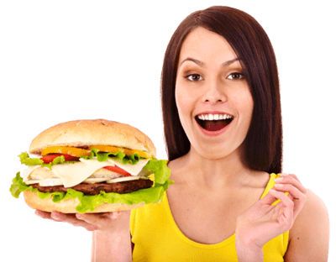
At the start of an experiment, a scientist must predict what they think will happen.
For example, if the aim of the experiment is to see if looking at food makes you hungry, their prediction might be:
"Looking at food makes people feel hungry."

Slide 6

This first prediction is then developed into a hypothesis, which is a scientific statement.
It follows the format:
"If the (dependent variable) is related to (independent variable), then (prediction)."
So in our example, the hypothesis could be:
"If hunger is related to food imagery, then looking at food will make people hungry."

Slide 7
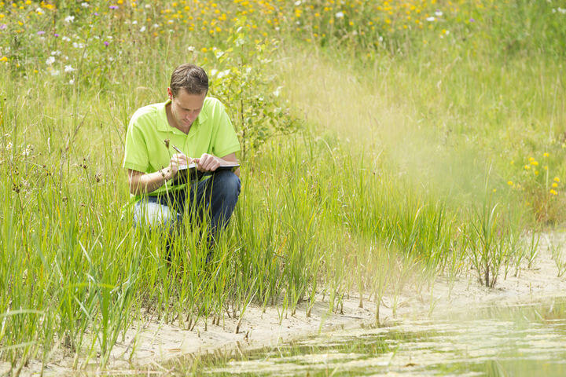
After a scientist has made their hypothesis, they must design an experiment to test their prediction!
An experiment is designed to gather evidence to either support or disprove the hypothesis.

Slide 8

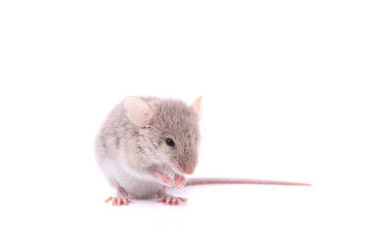
To make a hypothesis, you must be able to identify the dependent and independent variables in an experiment.
For example, let's take the mice and the Blogoflycin. The aim of this experiment was to see if taking Blogoflycin affects the life span of mice.
The independent variable is the one you control - the amount of Blogoflycin.
The dependent variable is the one you are measuring and testing - the mouse life span.

